Slide 1
SplitStream
by
Mikkel Hesselager Blanné
Erik K. Aarslew-Jensen

Slide 2
Program for today
Multicasting (streaming)
Challenges in p2p streaming
SplitStream
Algorithms
Experimental results

Slide 3
Streaming media
Multicast
Media – high bandwidth, realtime
1 source – distribution tree
Data loss – consequences:
  Quality degradation

Slide 4
Multicast tree

Slide 5
Multicast solutions
Current: Centralized unicast
Ideal: Min. Spanning Tree (IP-Multicast)
Realistic: Overlay multicast

Slide 6
Overlay multicast
peer
router
link stress
3
5
3
2
3
5
3
2
4
3
3
6
2
3
2
3
3

Slide 7
Problems with a single tree
Internal nodes carry whole burden
  with a fan-out of 16 less than 10% of the nodes are internal nodes – serving the other 90%
Deep trees => high latency
Shallow tree => dedicated infrastructure
Node failures
  a single node failure affects the entire subtree
  high fan-out lowers the effect of node failures

Slide 8
Fan-out vs. depth
Shallow tree
Deep tree
80% leaf nodes
50% leaf nodes

Slide 9
SplitStream
Split stream into k stripes
Fault tolerance:
  Erasure coding
  Multiple description coding
Multicast tree for each stripe:
  same bandwidth + smaller streams => shallow trees

Slide 10
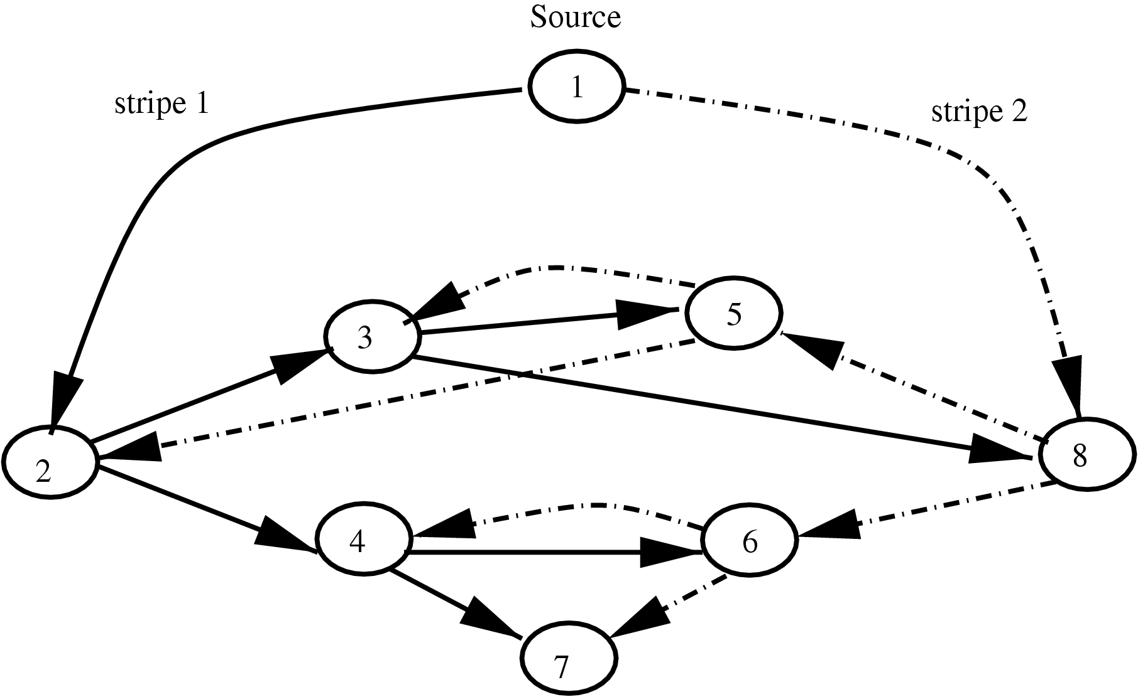
SplitStream
Interior-node-disjoint trees:
  Require nodes to be interior in at most one tree

Slide 11
SplitStream
Node failure affects only one stripe

Slide 12
Pastry
128 bit Keys/NodeIDs represented in
base 2^{b} digits
Prefix routing (numerically closest)
Proximity-aware routing tables
Scribe
Decentralized group management
”Efficient” Multicast trees
Anycast

Slide 13
Obtaining IND trees
Build on Pastry’s routing properties
(Pastry) 2^{b} = k (SplitStream)
Stripe id’s differ on the first digit
  Nodes are required to join (at least) the stripe that has the same first digit as their own ID.
Dedicated overlay network
  All nodes are recievers, no forwarders

Slide 14
The bandwidth problem
Scribe: Tree push-down
SplitStream: Must handle forest

Slide 15
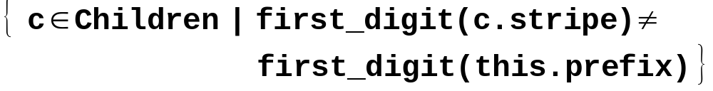
Adoption 1/2
Reject a random child in the set:
001*
084C
084*
001*
084C
080*
084C
1F2B
084C
Orphan on
1F2B
084C
084C
084C
084C
089*
08B*
081*
9*
089*
08B*
081*
9*

Slide 16
Adoption 2/2
Reject a random child in the set of children with the shortest prefix in common with the stripe_{ID}:
085*
084C
084*
085*
084C
080*
084C
084C
084C
Orphan on
084C
084C
084C
084C
084C
089*
08B*
081*
001*
089*
08B*
081*
001*

Slide 17
The Orphaned Child
Locate a parent amongst former siblings with the proper prefix,
”push-down”.
Search the Spare Capacity Group.

Slide 18
Spare Capacity Group
Anycast to the Spare Capacity Group
Perform depth-first search for a parent
4
Anycast for
stripe 6
0
1
5
spare: 0
2
3
in: {0,3,A}
spare: 2
in: {0,...,F}
spare: 4

Slide 19

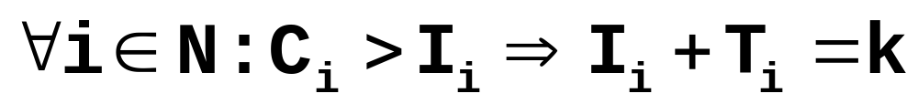
Feasibility
forwarding capacity
Condition 1:
Condition 2:
desired indegree
number of stripes
originating at node i

Slide 20
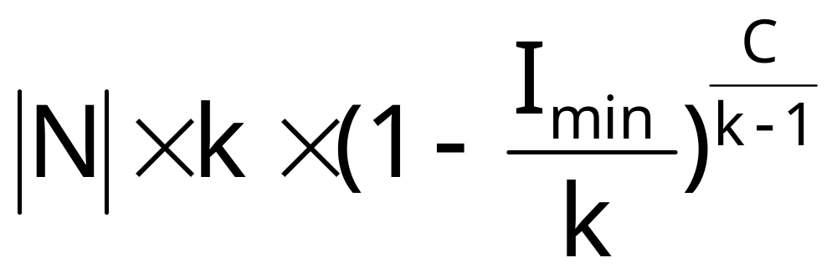
Probability of failure
total amount of
spare capacity
minimum number of stripes
recieved by any node
Example: |N| = 1,000,000, k = 16, I_{min} = 1, C = 0.01×|N|
Predicted probability of failure is 10⁻¹¹

Slide 21
Experimental setup
Pastry: 2^{b} = 16 (hexadecimals)
Number of stripes k = 16
Notation:
  x × y: indegree (x), forwarding capacity (y)
  (same for all nodes)
  NB: No bound

Slide 22
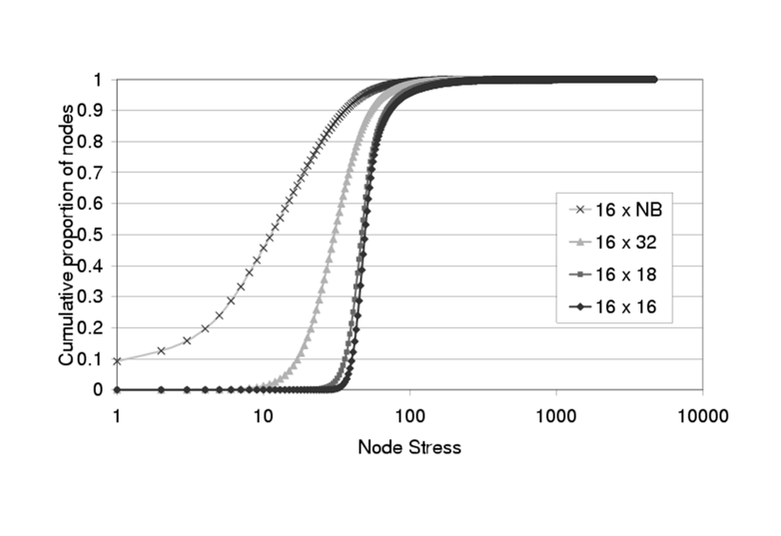
Forest creation: Node stress 1/2

Slide 23
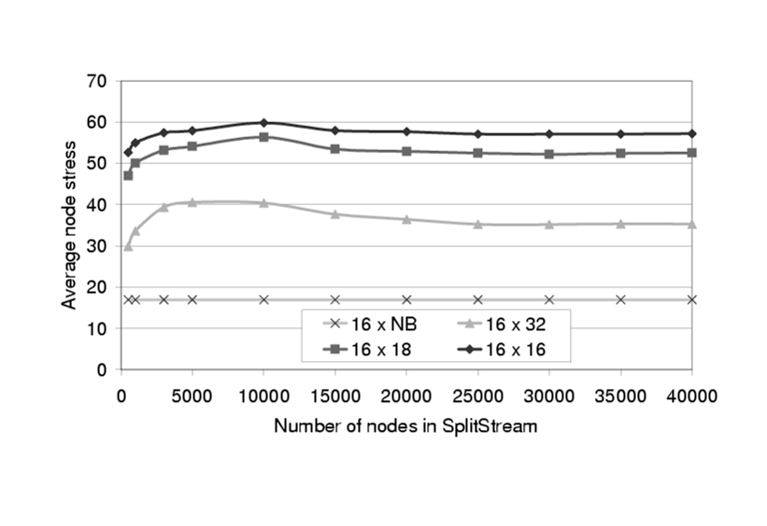
Forest creation: Node stress 2/2

Slide 24
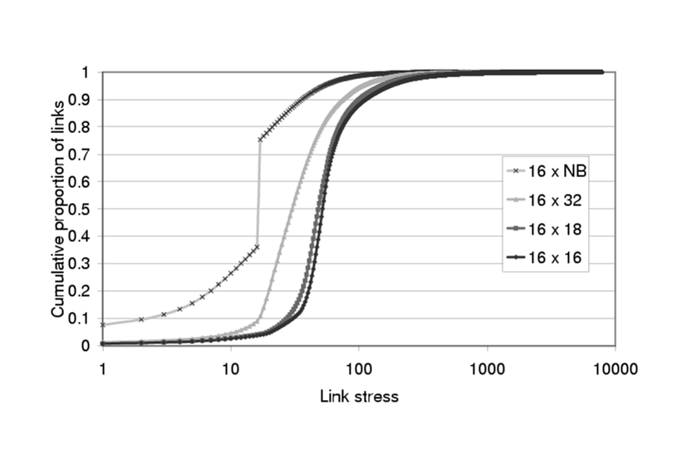
Forest creation: Link stress

Slide 25
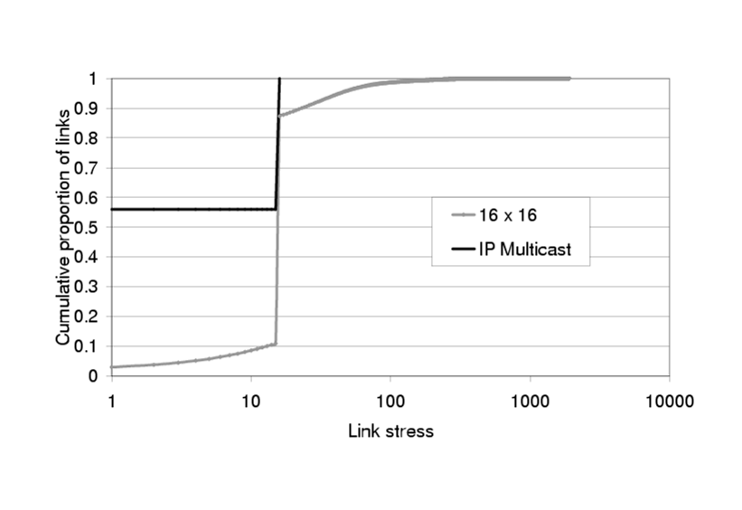
Multicast performance: Link stress 1/2

Slide 26
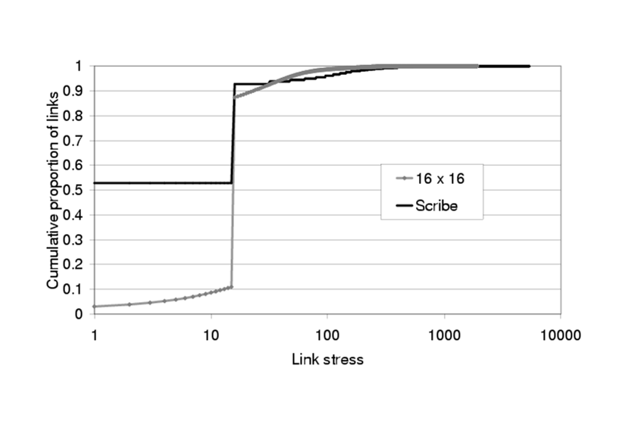
Multicast performance: Link stress 2/2

Slide 27
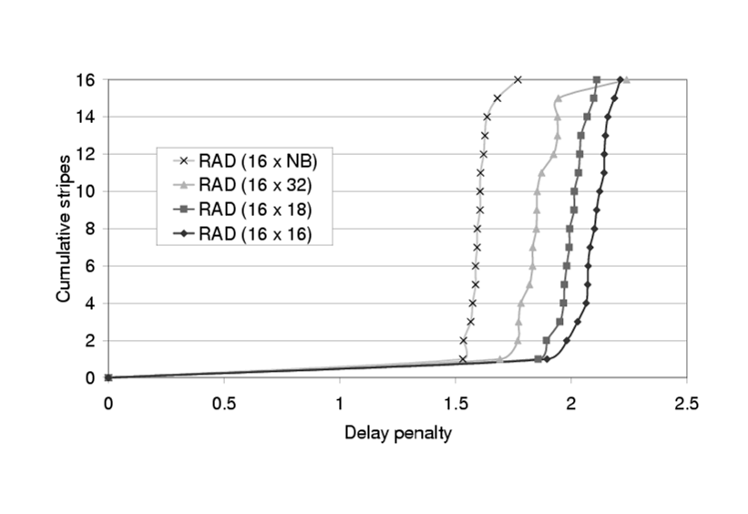
Multicast performance: Delay 1/2
RAD: Average delay ratio between SplitStream and IP Multicast

Slide 28
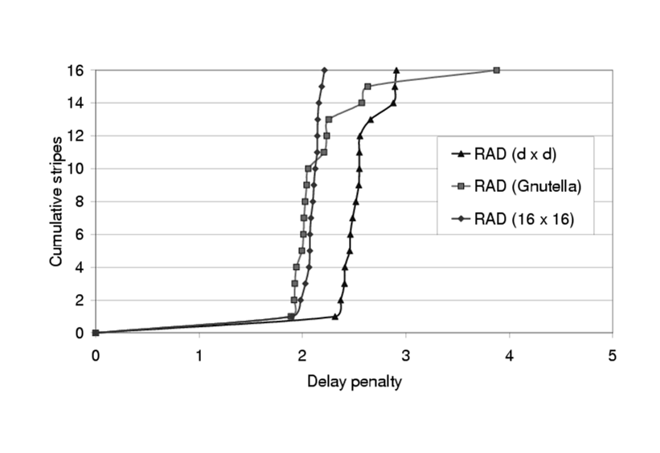
Multicast performance: Delay 2/2
RAD: Average delay ratio between SplitStream and IP Multicast

Slide 29
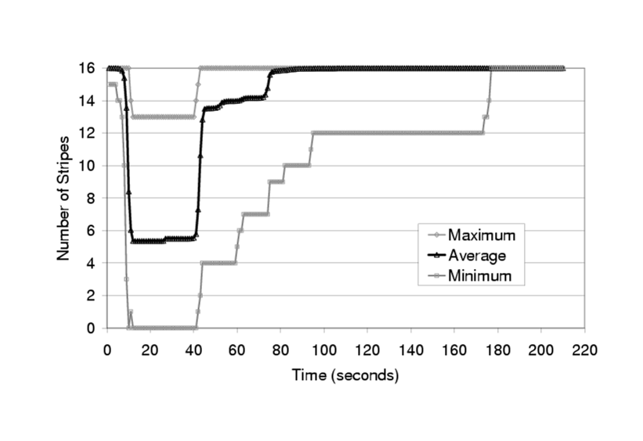
Node failures 1/2
10,000 nodes : 25% of the nodes fail after 10s

Slide 30
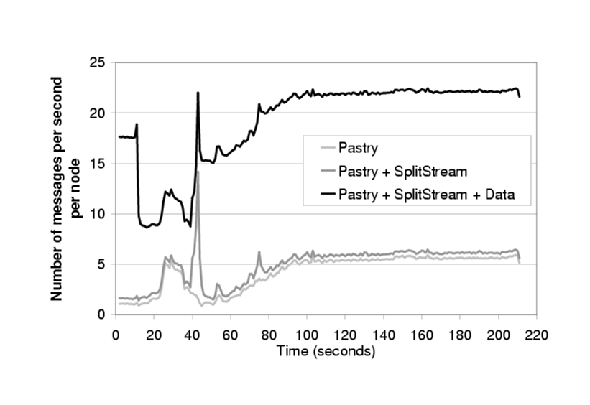
Node failures 2/2
10,000 nodes : 25% of the nodes fail after 10s

Slide 31
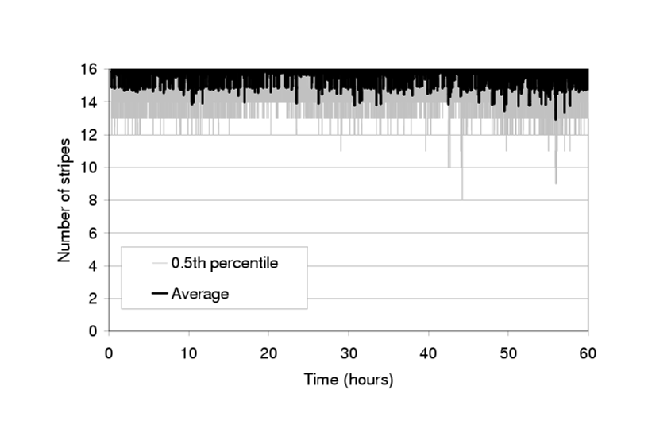
High churn: Gnutella trace
Gnutella: 17,000 unique nodes with between 1300-2700 active nodes
SplitStream: 16×20 with a packet every 10s

Slide 32
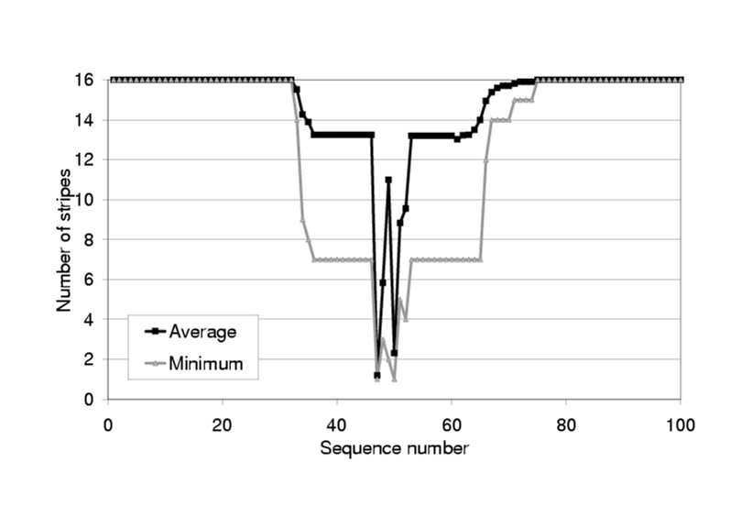
PlanetLab: QoS
36 hosts with 2 SplitStream nodes and 20Kbit/stripe every second
Four random hosts were killed between sequence number 32 and 50

Slide 33
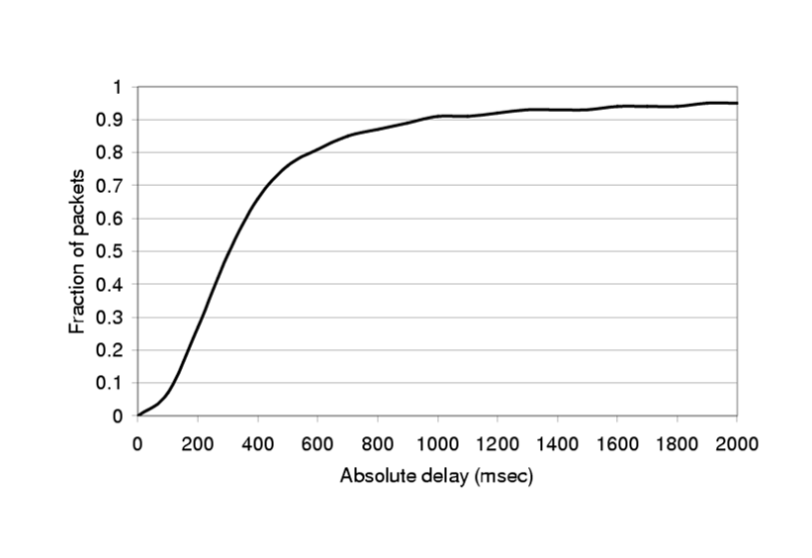
PlanetLab: Delay
Maximum observed delay is 11.7s

Slide 34
Conclusion
Scales very well
Needs little forwarding capacity
Timeouts should be adjusted
Caching should be added
Aproximately 33% extra data needed in erasure coding

